Slide 1
Beyond risk-based portfolios: balancing performance and risk contributions in asset allocation

Slide 2
Introduction
Evaluate and optimize risk-based portfolio such that the relative performance of the portfolio’s components is close to the portfolio’s relative performance
Risk-based portfolio using historical data rather than forecasting-based

Slide 3
Presentation
General framework
Applied framework
PRCC-optimization process
Effects of estimation error
Data
In sample performance and analysis
Out of sample performance and analysis
Replication study
Conclusion

Slide 4


General Framework - Portfolio Metrics
Performance:
Risk:
Relative performance:
First order homogeneous with properties:

Slide 5


General Framework – Component Metrics
Performance:
Risk:
Component performance/risk contribution:
Performance risk contribution concentration:
PRCC minimum is 0
Higher PRCC

Slide 6


Applied Framework
Mean and covariance:
Portfolio performance:
Portfolio risk:
Portfolio relative performance:
Component performance:
Component risk:

Slide 7
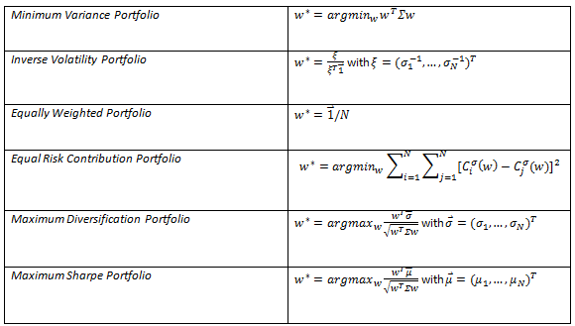
Long Only Reference Portfolios

Slide 8
PRCC-Optimization Process
Optimal weights and Sharpe ratio found for a reference portfolio
PRCC program
Tilt weights in direction such that component Sharpe equals portfolio Sharpe
Sharpe and tracking error constraints seek to limit impact of estimation error
No analytical solution
Sequential quadratic programming

Slide 9
Effects of Estimation Error
Evaluate impact of mean excess return estimation error
Covariance estimation error not considered
6 reference portfolio rules
10 asset universe
6 perturbations on each assets mean return
0.5, 0.75, 1.25, 1.5, 1.75, 2

Slide 10
Effects of Estimation Error - Process
Optimal weight w* is calculated once for the maximum Sharpe and five PRCC-optimized under no estimation error assumption.
Optimal weight w^ is calculated for the maximum Sharpe and five PRCC-optimized under each of the perturbation assumptions applied separately to each asset. This yields 10 scenarios under each of the 6 perturbations for each of the 6 portfolio rules; 360 total.
Four weight metrics are calculated for each scenario. The worst case among the ten assets per each of the six portfolio rules per each of the six perturbations are reported.
Four performance ratio metrics are calculated. The worst case among the ten assets per each of the six portfolio rules per each of the six perturbations are reported.

Slide 11

Effects of Estimation Error - Metrics
.
Mean Absolute Deviation
Number of near zero perturbed weights
Max perturbed weight
Normalized Herfindahl index:
Ratio metrics
PRCC(w^)

Slide 12
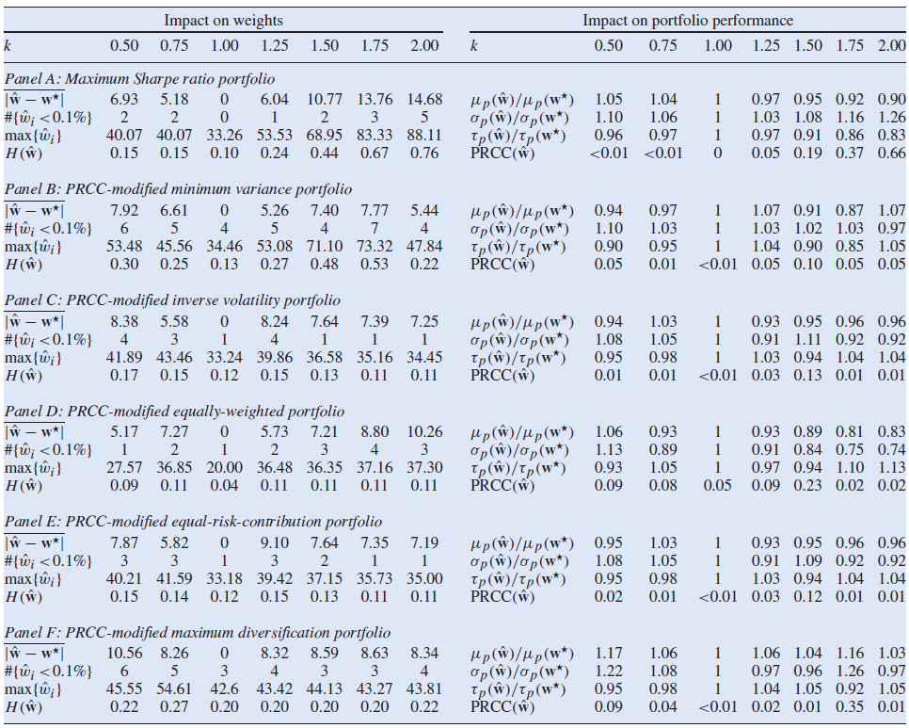
Effects of Estimation Error - Analysis

Slide 13
Data
Developed market equity
Emerging market equity
US government bonds
US corporate investment grade bonds
Real estate
Gold
One month US treasury risk free rate
Jan 1988 – August 2015 (332 months)

Slide 14
In Sample - Process
6 reference portfolios and 5 PRCC-optimized portfolios
Calculate optimal reference and PRCC-optimized weights using all of the data
Tracking error constraint of 10%
Calculate annualized portfolio and component metrics using sample statistics

Slide 15
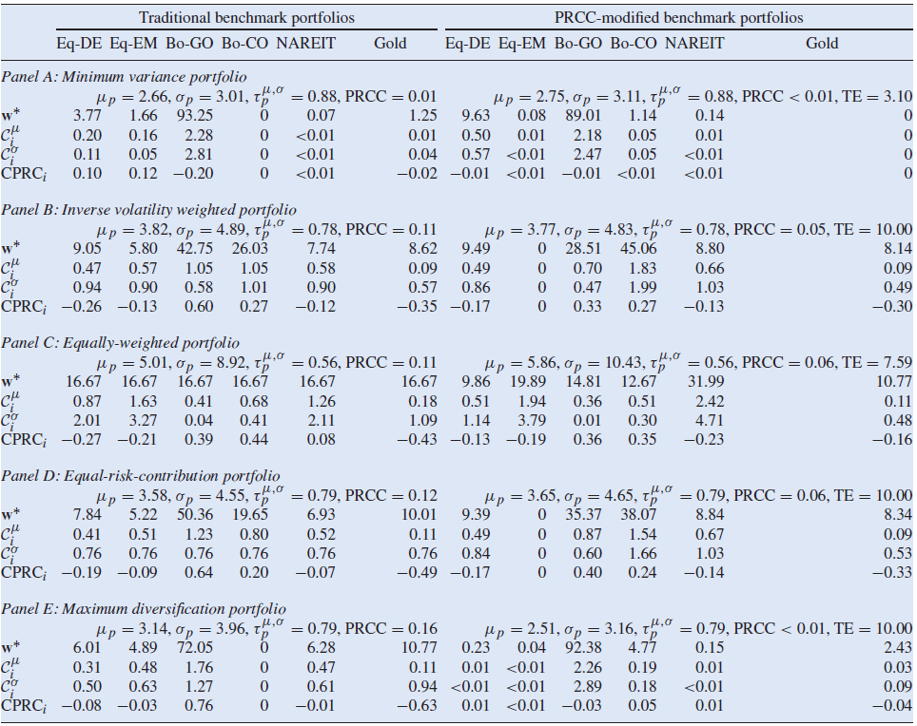

Slide 16
Out of Sample - Process
6 reference portfolios and 5 PRCC-optimized portfolios
Monthly rebalancing on a 36 month rolling window (296 monthly observations)
9 return series statistics: cumulative return of 1$, annualized geometric return, annualized mean returns, annualized standard deviation, Sharpe ratio, skewness, kurtosis, maximum drawdown and modified value-at risk
Average tracking error for PRCC-optimized portfolios

Slide 17
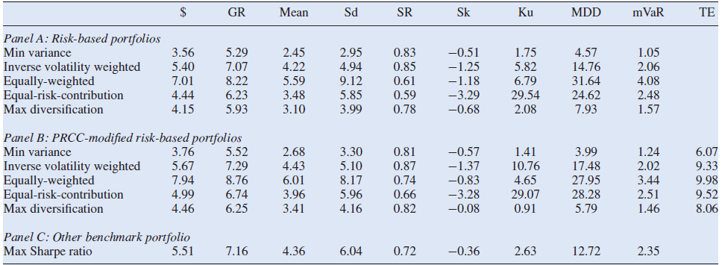
Out of Sample - Analysis

Slide 18
Replication Study
Removed US Government bond index
Python SciPy Optimization library
No analytical solutions since optimizations are all long only
Interesting tolerance issue with PRCC optimization

Slide 19
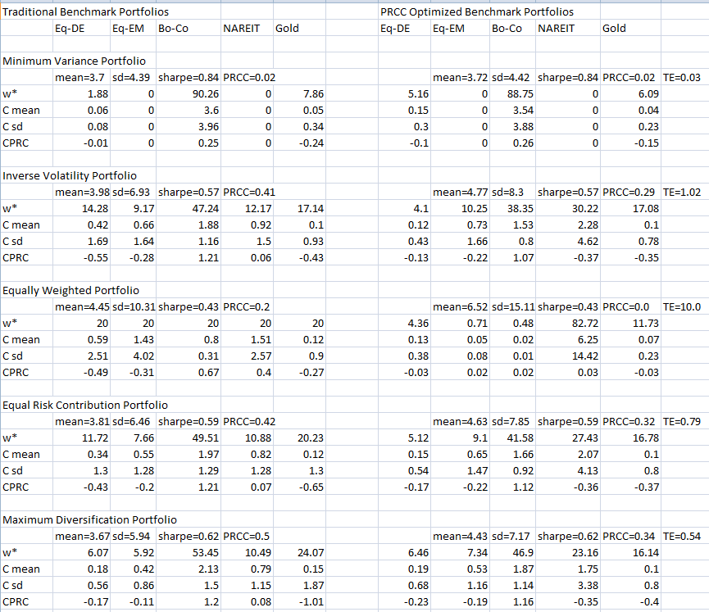

Slide 20
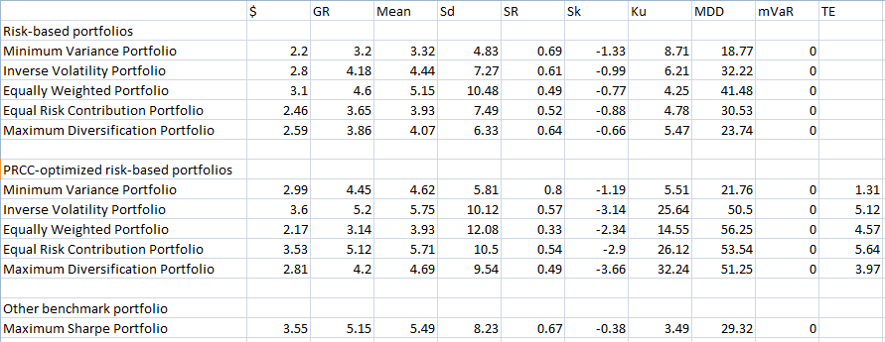
Out of Sample - Analysis

Slide 21
Conclusion
Basic approach but with an unfamiliar aspect
Other metrics to be considered
Allow for constraints to be loosened
Larger universe of assets

